Slide 1


Day 5
Math24 (Differential Equations)
Ch 2.1 Linear Equations; Method of Integrating Factors (Page 31-42)
Elementary Differential Equations and Boundary Value Problems, 10th edition, by William E. Boyce and Richard C. DiPrima, ©2013 by John Wiley & Sons, Inc.

Slide 2
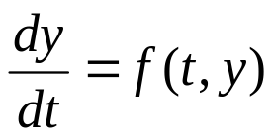

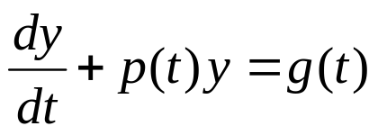
A linear first order ODE has the general form
where f is linear in y. Examples include equations with constant coefficients, such as those in Chapter 1,
or equations with variable coefficients:

Slide 3
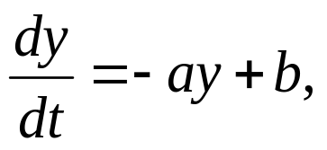
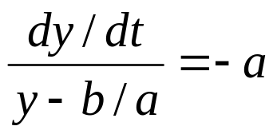
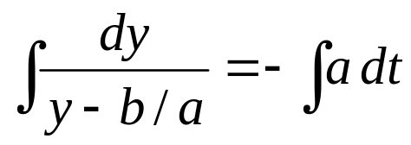
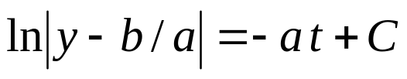

Constant Coefficient Case
For a first order linear equation with constant coefficients,
recall that we can use methods of calculus to solve:

Slide 4
Variable Coefficient Case:
Method of Integrating Factors
We next consider linear first order ODEs with variable coefficients:
The method of integrating factors involves multiplying this equation by a function μ(t), chosen so that the resulting equation is easily integrated.

Slide 5
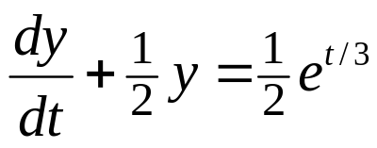
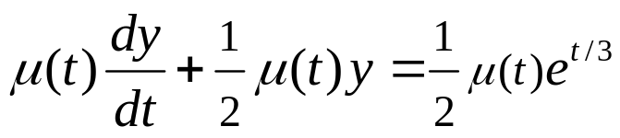
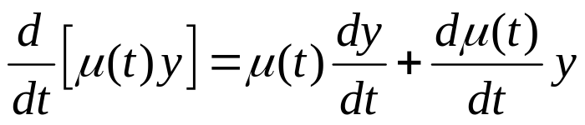
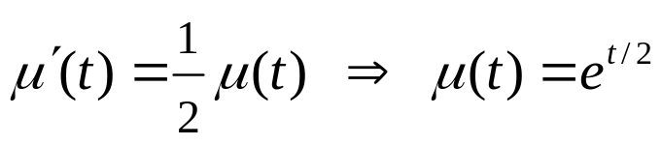
Example 2: Integrating Factor (1 of 2)
Consider the following equation:
Multiplying both sides by μ(t), we obtain
We will choose μ(t) so that left side is derivative of known quantity. Consider the following, and recall product rule:
Choose μ(t) so that

Slide 6
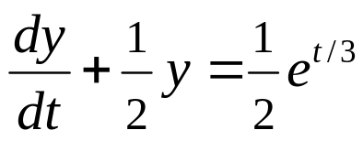
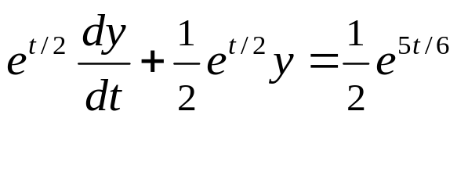

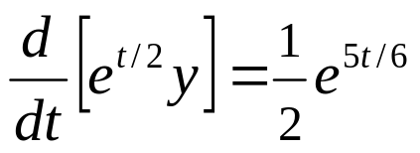
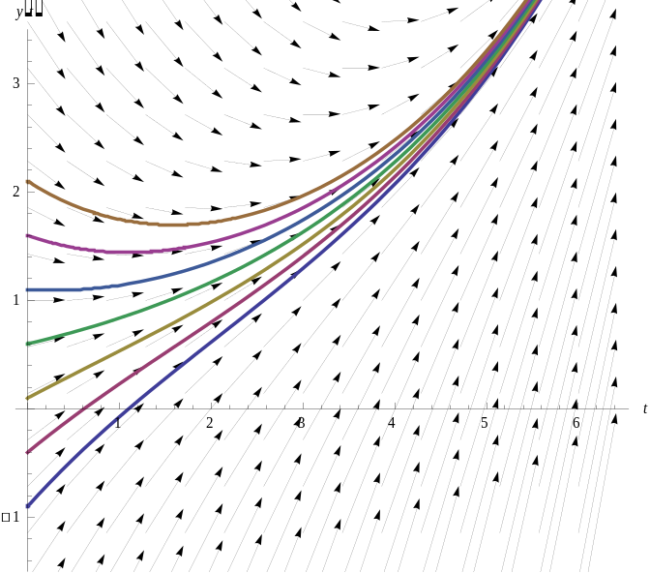
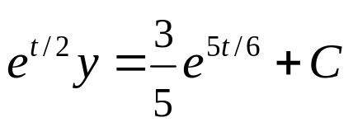
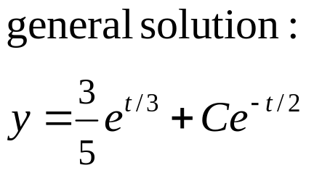
Example 2: General Solution (2 of 2)
With μ(t) = e^{t/2}, we solve the original equation as follows:

Slide 7
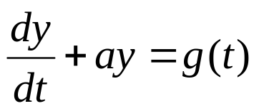
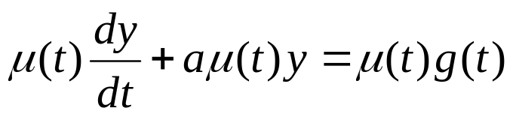
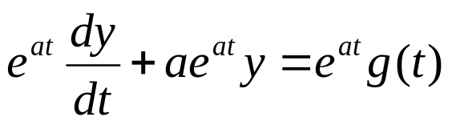
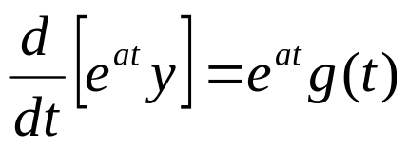
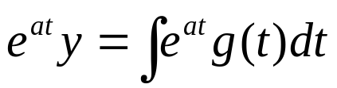
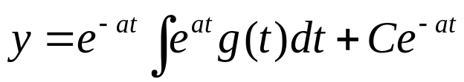
Method of Integrating Factors:
Variable Right Side
In general, for variable right side g(t), the solution can be found as follows:

Slide 8
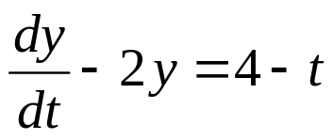
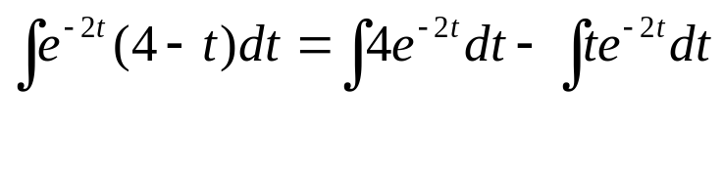
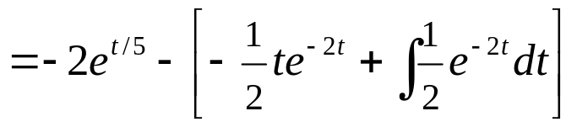
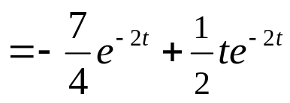
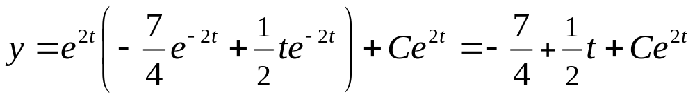
Example 3: General Solution (1 of 2)
We can solve the following equation
using the formula derived on the previous slide:
Integrating by parts,
Thus

Slide 9
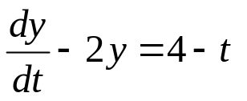
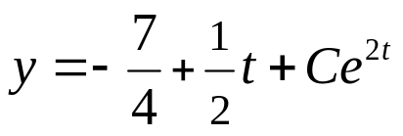
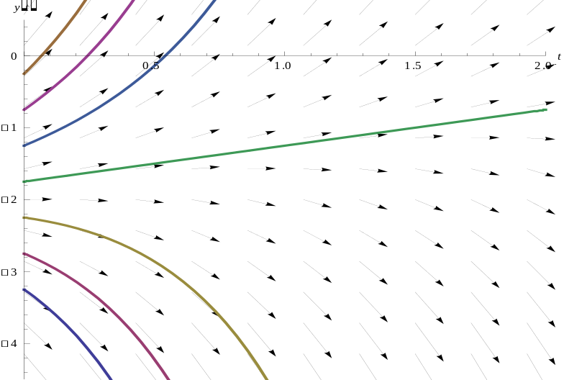
Example 3: Graphs of Solutions (2 of 2)
The graph shows the direction field along with several integral curves. If we set C = 0, the exponential term drops out and you should notice how the solution in that case, through the point (0, -7/4), separates the solutions into those that grow exponentially in the positive direction from those that grow exponentially in the negative direction..

Slide 10
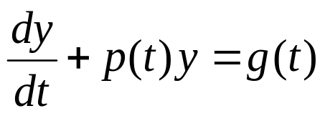
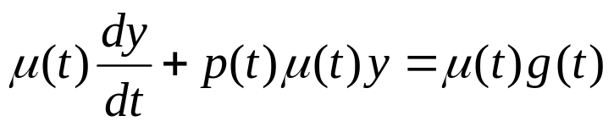
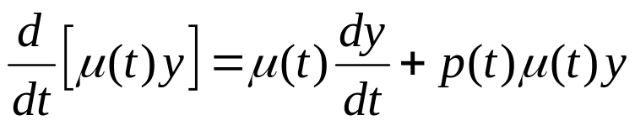
Method of Integrating Factors for
General First Order Linear Equation
Next, we consider the general first order linear equation
Multiplying both sides by μ(t), we obtain
Next, we want μ(t) such that μ'(t) = p(t)μ(t), from which it will follow that

Slide 11
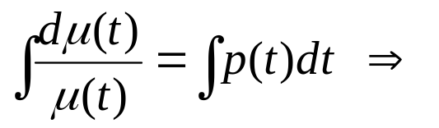
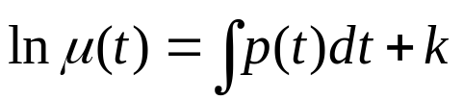
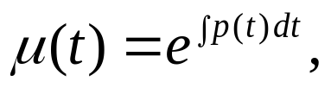
Integrating Factor for
General First Order Linear Equation
Thus we want to choose μ(t) such that μ'(t) = p(t)μ(t).
Assuming μ(t) > 0, it follows that
Choosing k = 0, we then have
and note μ(t) > 0 as desired.

Slide 12

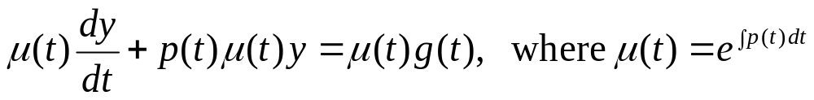
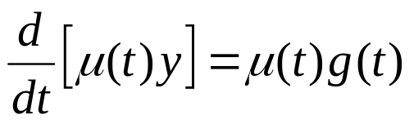
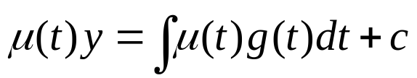
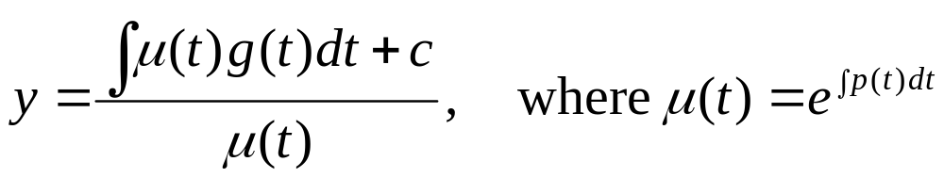
Solution for
General First Order Linear Equation
Thus we have the following:
Then

Slide 13

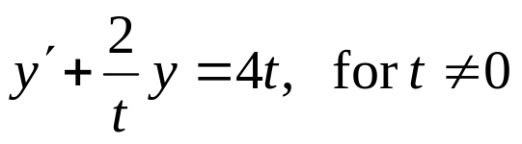
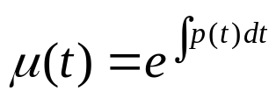
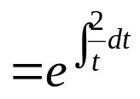



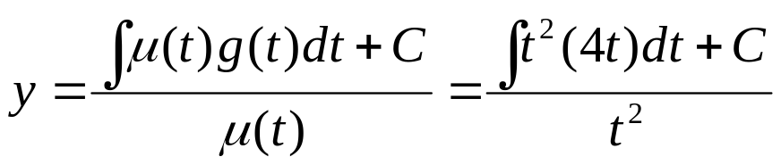
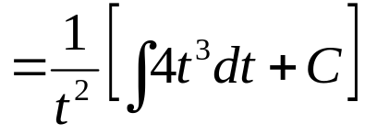
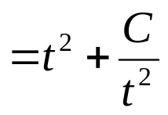
Example 4: General Solution (1 of 2)
To solve the initial value problem
first put into standard form:
Then
and hence

Slide 14
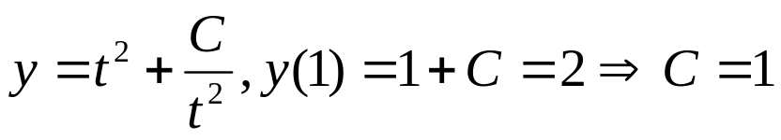
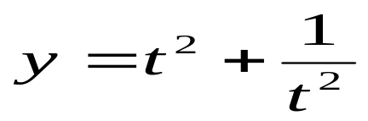
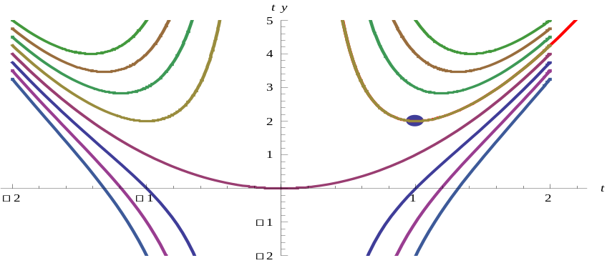
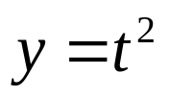

Example 4: Particular Solution (2 of 2)
Using the initial condition y(1) = 2 and general solution
it follows that
The graphs below show solution curves for the differential equation, including a particular solution whose graph contains the initial point (1,2). Notice that when C=0, we get the parabolic solution (shown)
and that solution separ-
ates the solutions into
those that are asymptotic
to the positive versus
negative y-axis.
(1,2)

Slide 15







Example 5: A Solution in Integral Form (1 of 2)
To solve the initial value problem
first put into standard form:
Then
and hence

Slide 16


Example 5: A Solution in Integral Form (2 of 2)
Notice that this solution must be left in the form of an integral, since there is no closed form for the integral.
Using software such as Mathematica or Maple, we can approximate the solution for the given initial conditions as well as for other initial
conditions.
Several solution curves
are shown.

